Slide 1
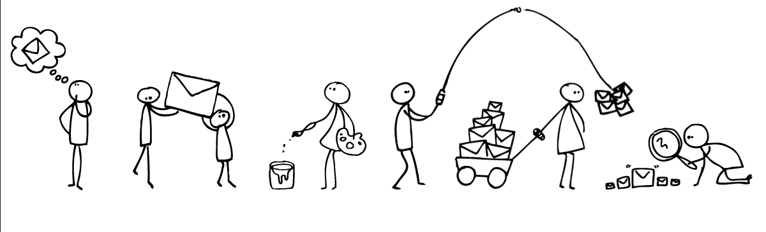
AW Workflow with Synergist
Prepared by Claire Rollinson, November 2012

Slide 2
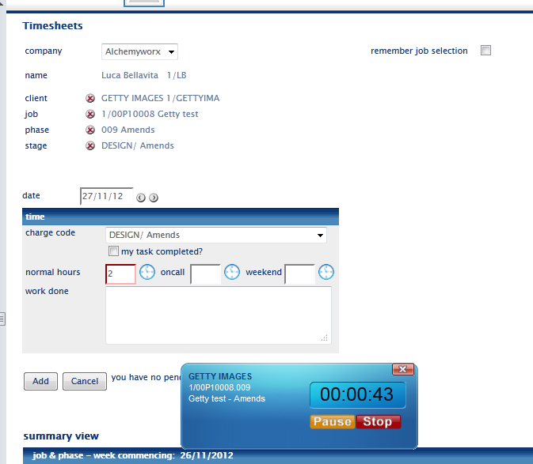
Production completing timesheets
Once you are happy with everything you can start the job!
Click on the clock to start the automatic timer/stopwatch

Slide 3
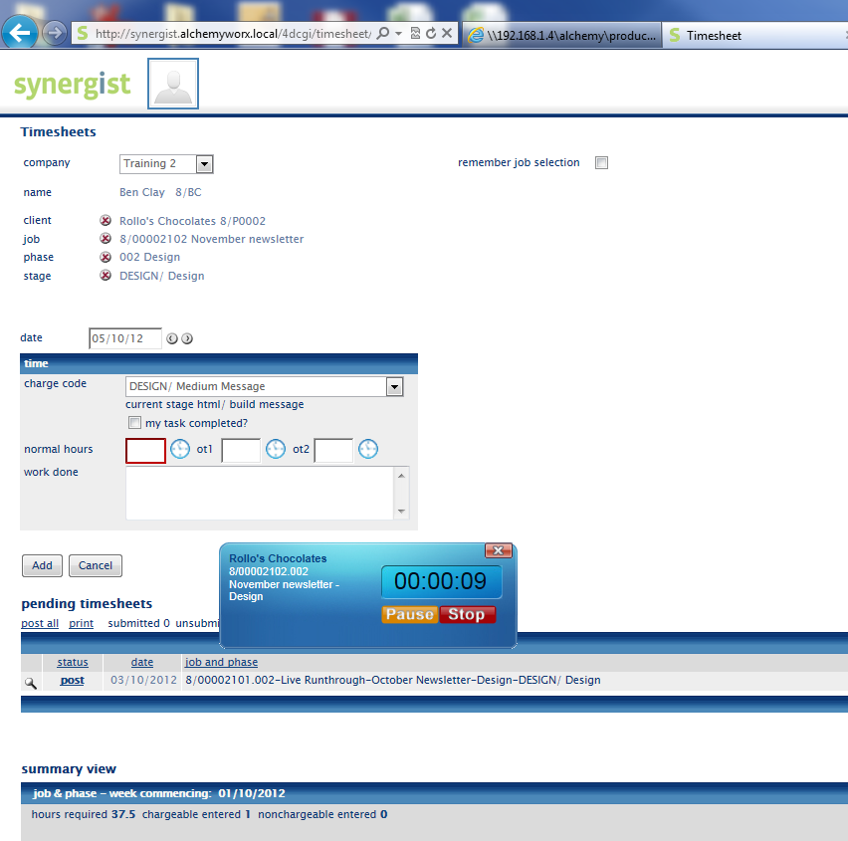
Once you have completed job
Click on ‘stop’ to stop the automatic clock timer
Then click ‘add’ to add this time to your pending timesheets

Slide 4
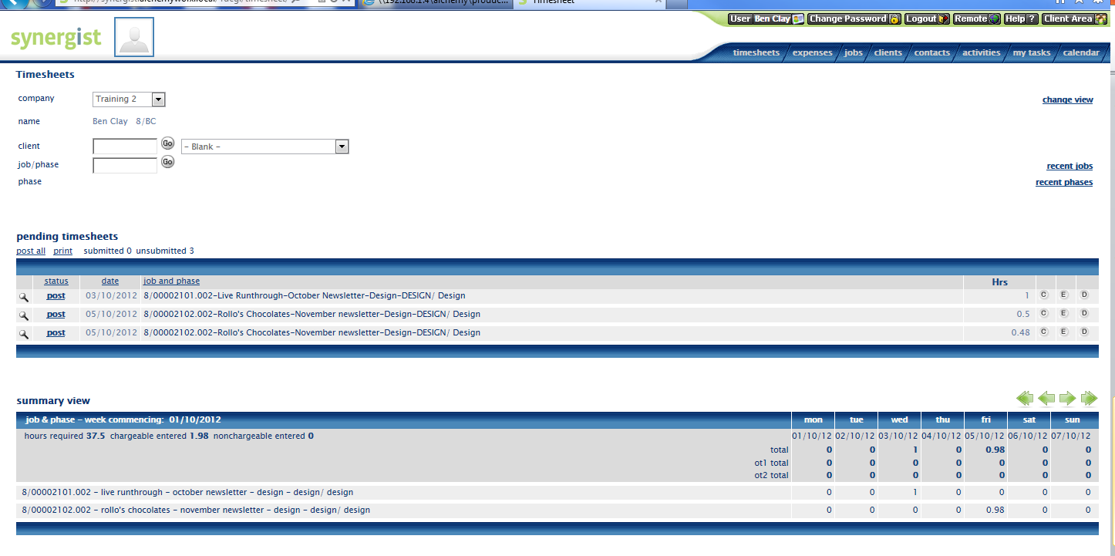
At the end of the day…
You need to do two things:
Post all your pending timesheet entries – very important! (instruction below)
Post all entries at the end of each day

Slide 5
Production posting timesheets
Post all entries at the end of each day

Slide 6
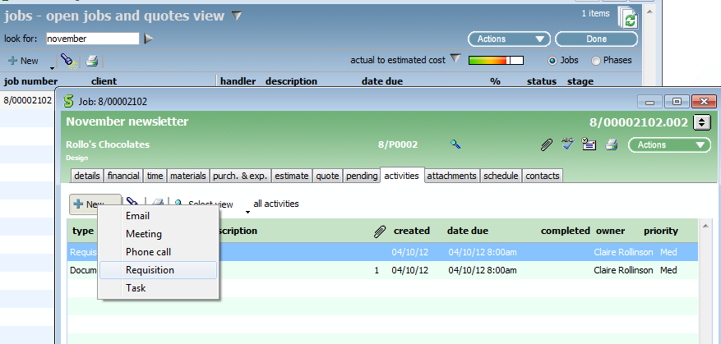
Raising a requisition
General
CM to raise a ‘requisition’ whenever a phase is ready to be worked on
A requisition is raised by going into the activity section of the stage, within the phase
Navigate to phase, then stage, then to the ‘activities’ tab

Slide 7
Raising a requisition - 2
General
Write details in the subject line and add any further info in ‘details’ section
Add ‘team’ the request is for. (eg design or HTML. This will need to completed to enable the team to view all outstanding requisitions)
the requisition owner is the team leader of the dept completing the work. So for design it would be Luca/ for HTML it will be ?? / copy Dan Hamilton/ Data Robin/ Deployment Canda / QA Andrew Yau
the secondary owner/team member would be the CM and QA (you need to add Andrew Yau and Carmen Quist) tick the ‘immediate alert’ box and the team leader will receive an email notification indicating job is ready. It will also appear in the calendar bookings as a job to be worked on.
Please add due date and time of when the request needs to be completed by
tick the ‘on completion’ box you will also receive a notification it has been completed once the owner ‘completes’ requisition

Slide 8
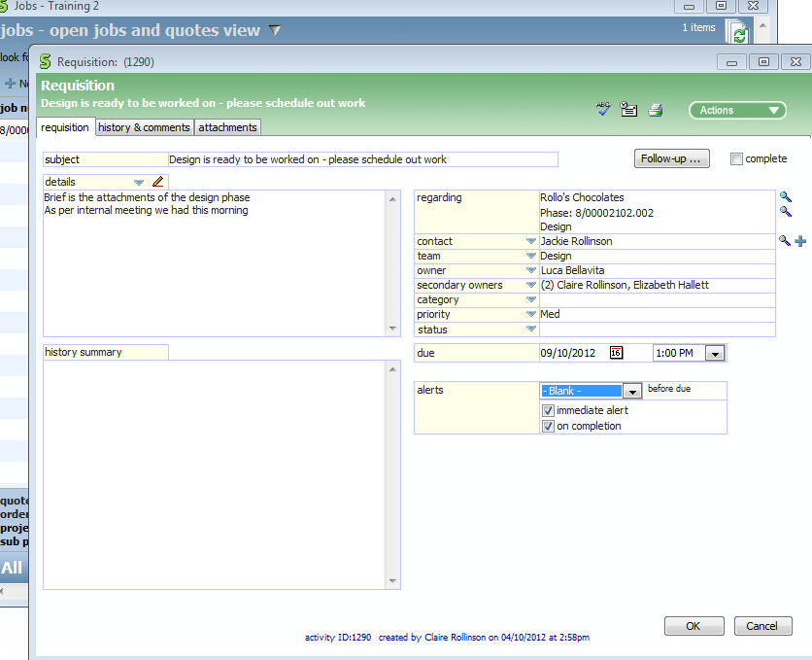
Raising a requisition - 3
Also add QA as a secondary owner– Andrew Yau and Carmen Quist

Slide 9
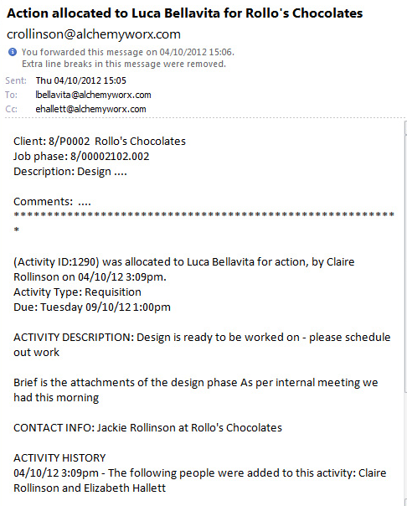
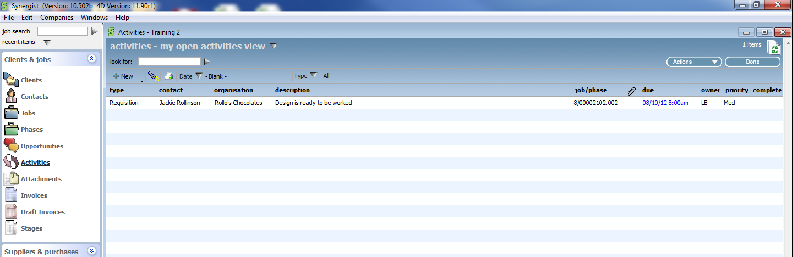
Requisition received - 4
The team leader will now receive an email notification and a requisition request under their open activities to schedule out stage task

Slide 10
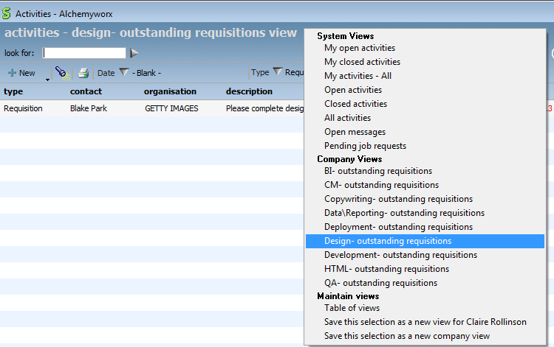
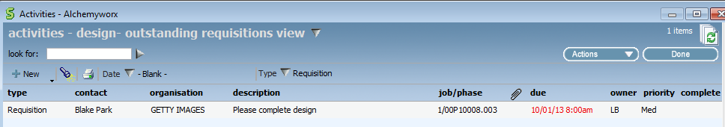
Requisition received - 5
As long as the CM adds the ‘team’ to the requisition request you will be able to view all non-completed requisitions by team in the company views created below in the ‘activities’ menu

Slide 11
Team Leaders: Production Scheduling jobs to your team…

Slide 12
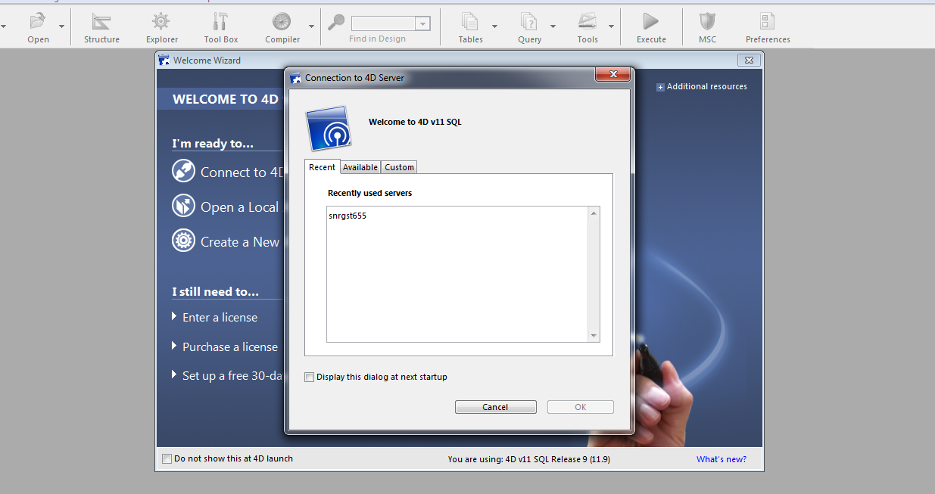
Log into this version of Synergist:
CLICK HERE!

Slide 13
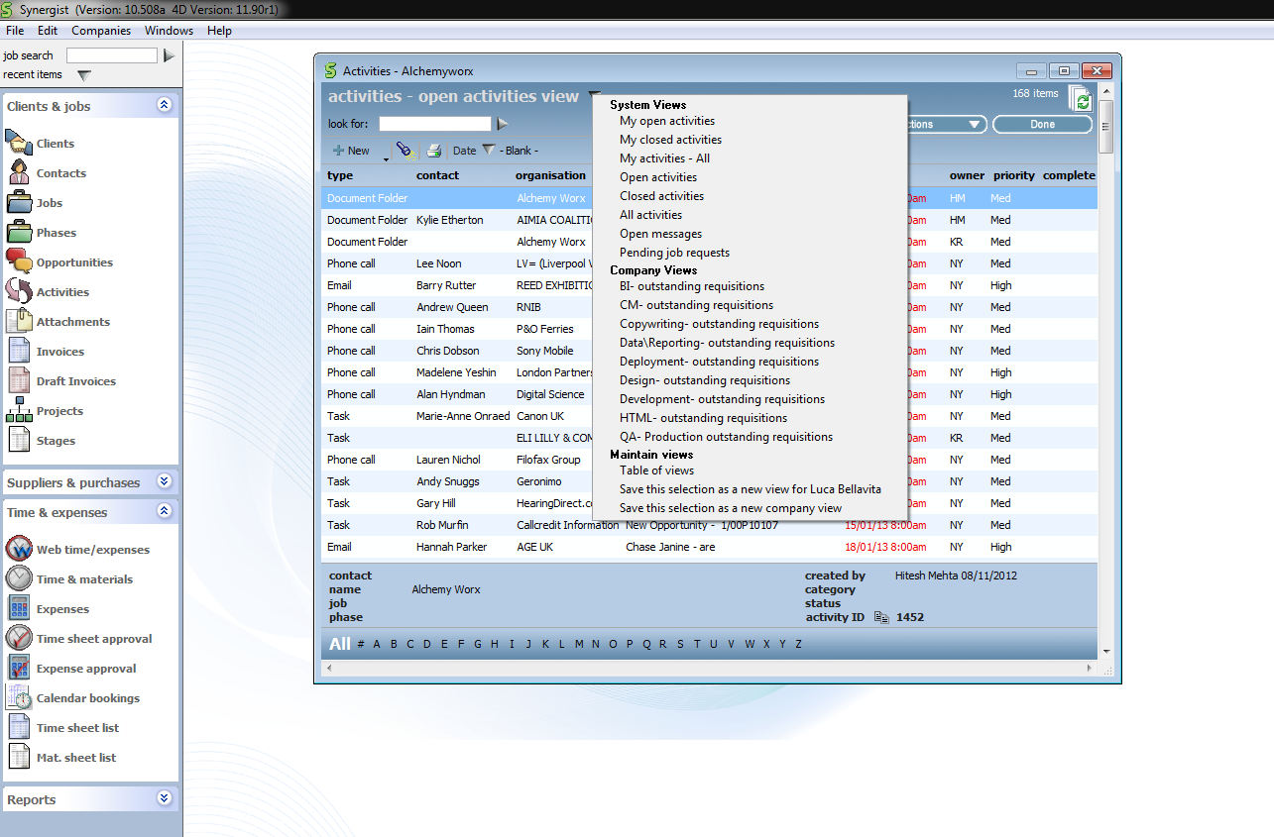
Another team view….
To see outstanding requisitions for just your team in one view, follow these instructions…..
2
Click on activities on the left handed column
Then click on “open activities view”
Then Company views – HTML, design, deployment etc. for outstanding requisitions
1
3

Slide 14
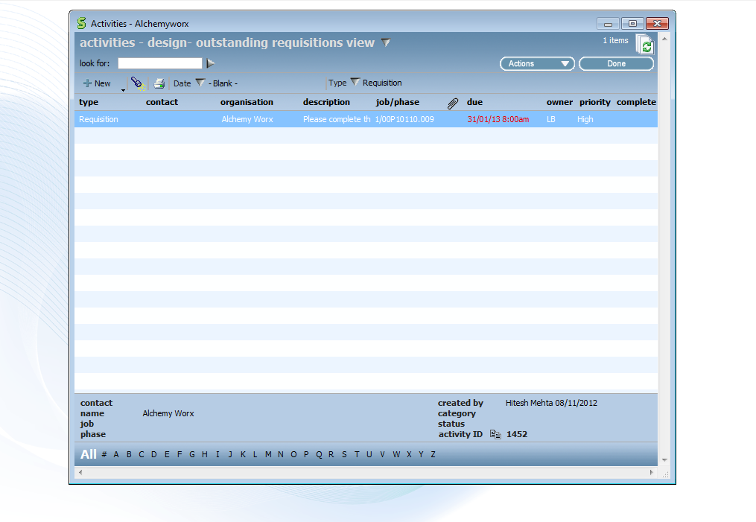
Example of Team View….
Following the instructions from the previous slide this is the view you will see.

Slide 15
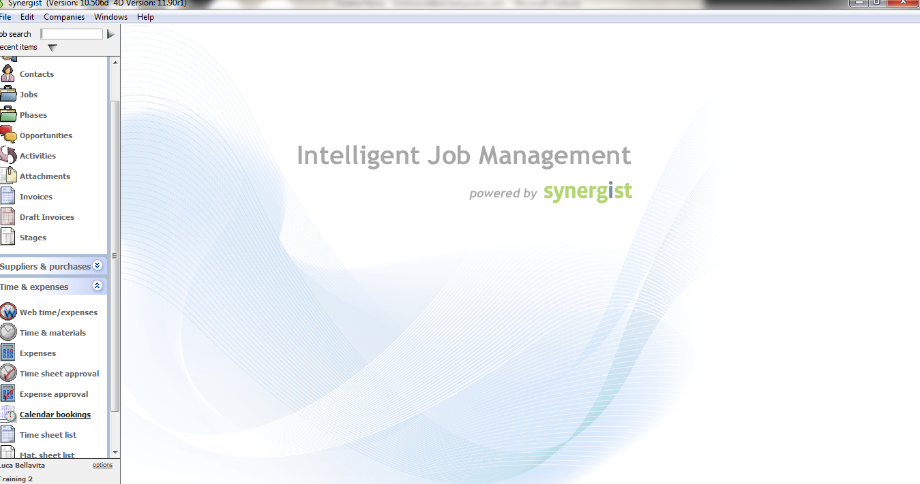
Finding the live jobs…
Step 1. Click on Time & expenses
Step 2. Click on Calendar bookings

Slide 16
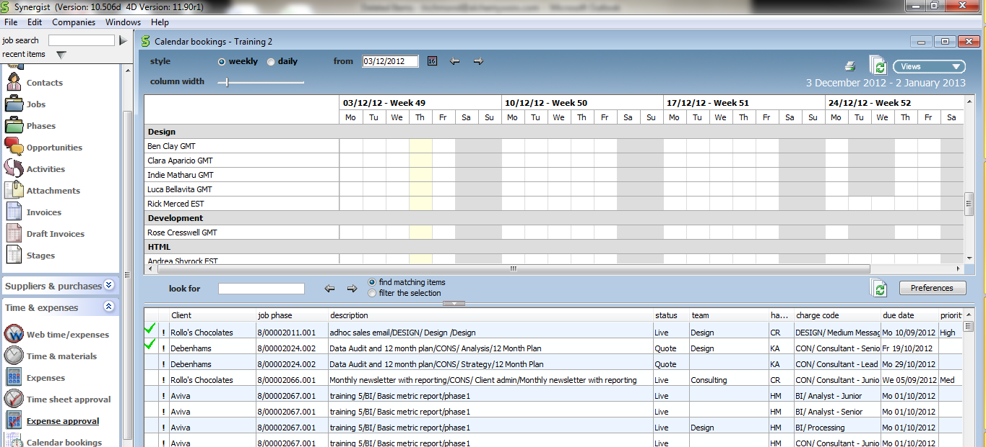
Finding the live jobs…
Double click in the top bar next to the word “client” to ensure all jobs that need to be scheduled show at the top…
Jobs that have an exclamation mark against them are outstanding and
need to be allocated to one of your team members. The exclamation mark
is a “requisition”

Slide 17
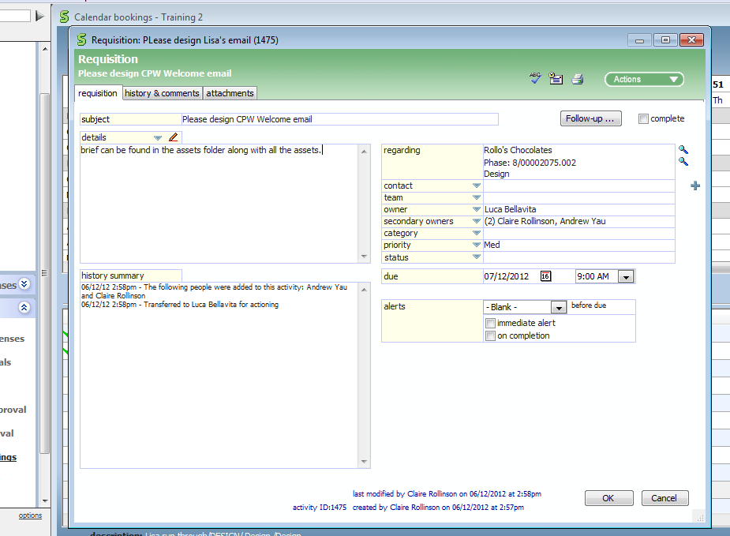
Reading the requisition…
Right click on the exclamation mark to “open the requisition”
Here you will find all details of the job:
Which CM
Where the brief/assets are saved
Priority
Note: there will be no attachments. The brief will be kept in assets on the server as per the current process.

Slide 18
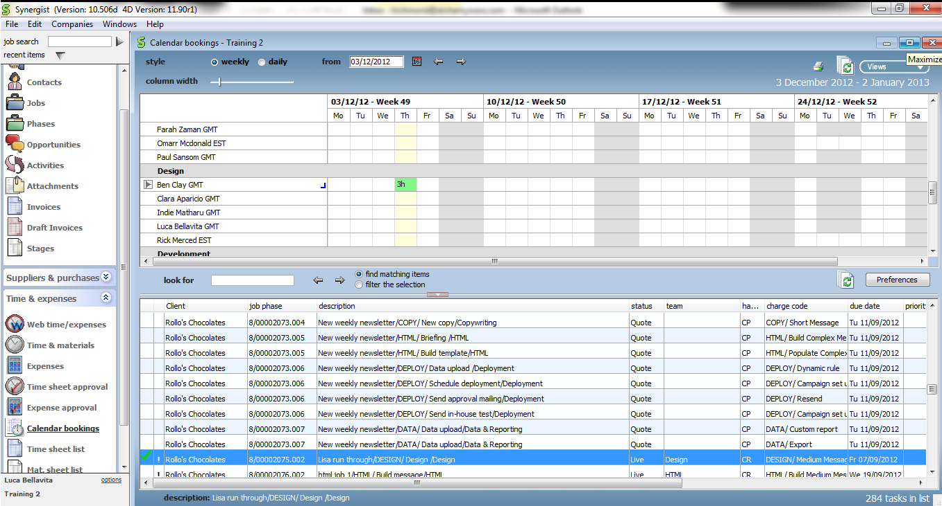
Scheduling the job: Step 2
Now you need to drag and drop the job into the team members calendar as follows:
Click on the job, so that it is highlighted
Then drag and drop to the person above in your team
As you can see Ben now has the time allocated against him and will have been sent a job alert email
And below the job now has a green tick against it which means it has been dealt with
The job can now be started!

Slide 19
Scheduling the job: Step 1
Change the name of the owner to the person you want to schedule it to. An email will be send to them to inform them of the job
Add yourself as a secondary owner so you receive an email update when complete
Ensure Andrew Yau and Carmen Quist have been added from QA team as well
Check you agree with the “due” time. Talk to the CM if you need more time
Ensure both Tick boxes are checked in "alerts”
Immediate alert
On completion
Then click OK!

Slide 20
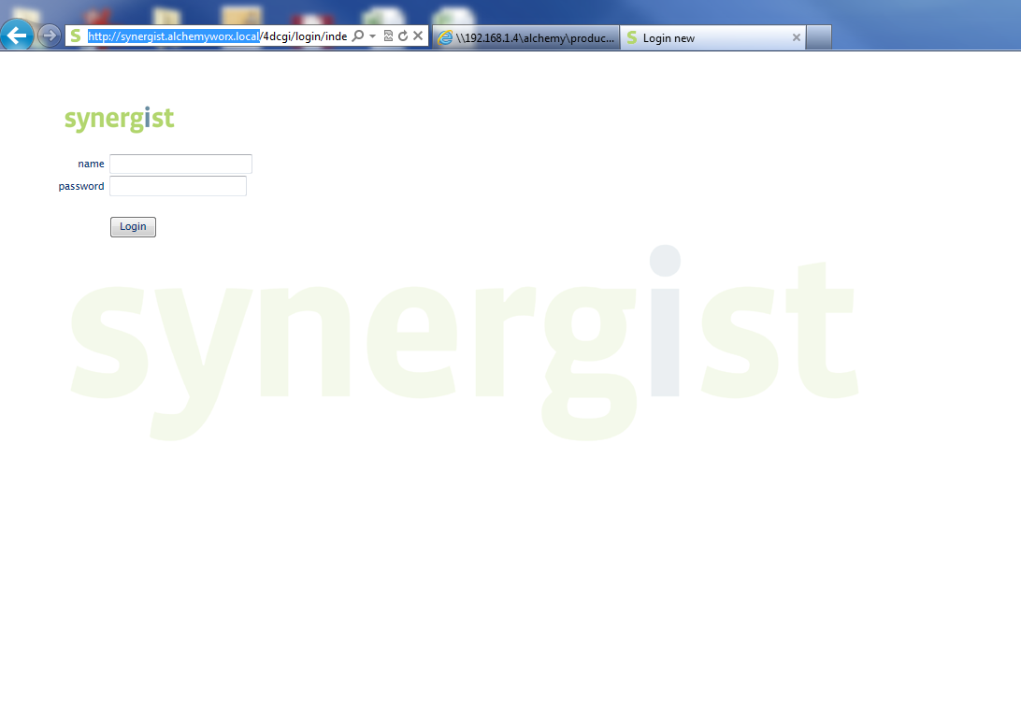
Production Logging into Synergist (for those on web licences)

Slide 21
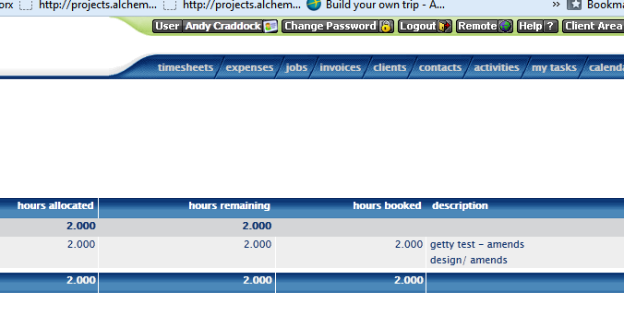
Production – viewing tasks
Navigate to your dashboard
Click on ‘my tasks’ in the top right hand side

Slide 22
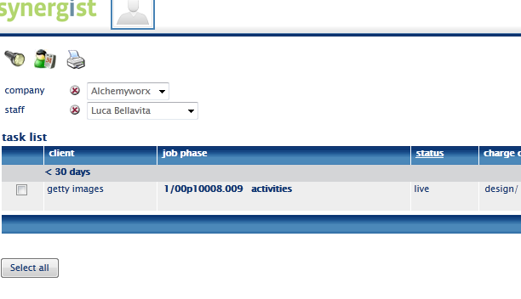
Production - viewing tasks
Ensure company is set to ‘Alchemy Worx’
And staff member is set to yourself. This will show all tasks that have been assigned to you.

Slide 23
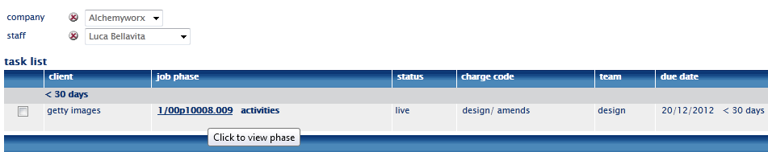
Production completing task
Double click on ’job phase’ to start work on the task/stage you have been assigned via the requisition request from your team leader

Slide 24
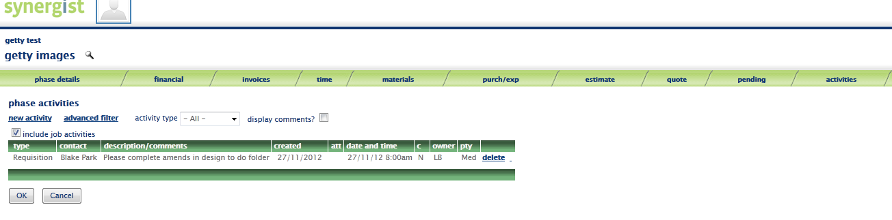
Production completing task -2
You should now be able to view the ‘requisition’ request from the CM, sent to you via your team leader ( if you cannot view it, please click on the ‘activities tab’)
Click on the description to view the request which has been sent to you
The brief/ to do details will be in the project/client folders on the server as usual

Slide 25
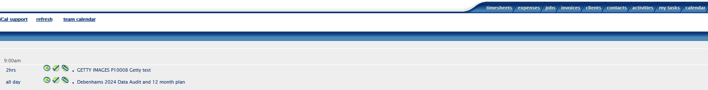
Production completing task -3
Click on ‘calendar’ in the top right
By viewing the ‘calendar’ this is another view you can use to see all the tasks that have been assigned to you
Then click on ‘timesheet’ for the job you are working on

Slide 26
Production completing task -4
Once you are happy with everything you can start the job!
Click on the clock to start the automatic timer/stopwatch

Slide 27
Once you have completed job
Click on ‘stop’ to stop the automatic clock timer
Then click ‘add’ to add this time to your pending timesheets

Slide 28
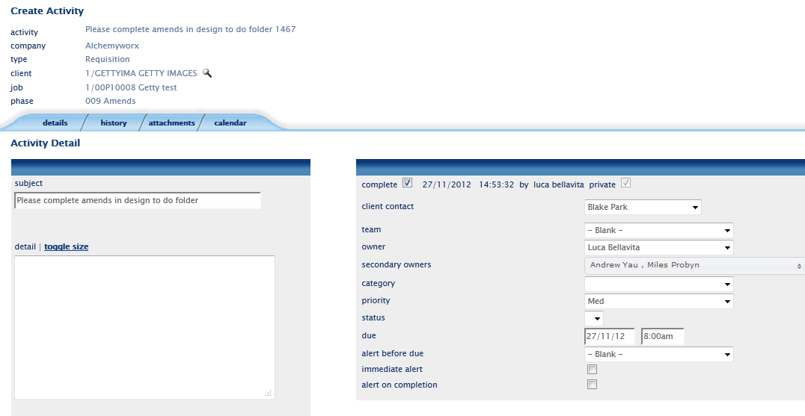
Production completing the task activity
Completing the requisition request
To complete the requisition request, you need to do two things:
Navigate to “my tasks” and ‘complete’ the activity task so the CM/team leader/QA knows it has been completed. See instruction below..
You then need to create a “follow up” so a requisition is sent to the QA team so they know the job is ready for QA. Instructions for this are on the next slide…
Tick the ‘complete’ box

Slide 29
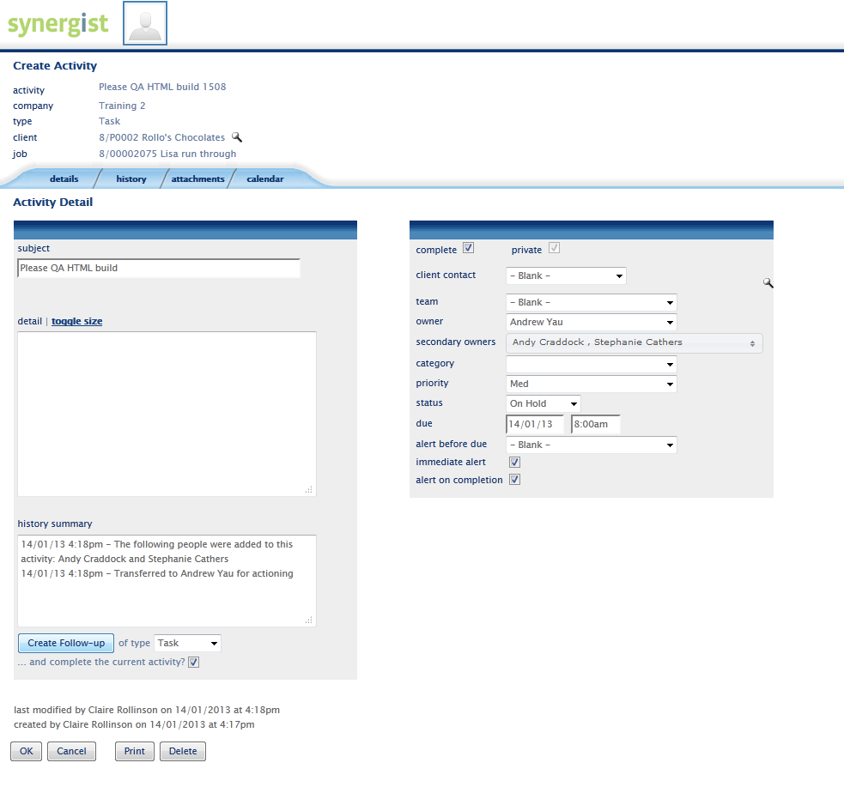
Production completing the task activity
Completing the requisition request
You then need to create a “follow up” so a requisition is sent to the QA team so they know the job is ready for QA:
Already ticked as per previous slide
As well as adding the QA team as secondary owners, also add the CM
Click “follow up”

Slide 30
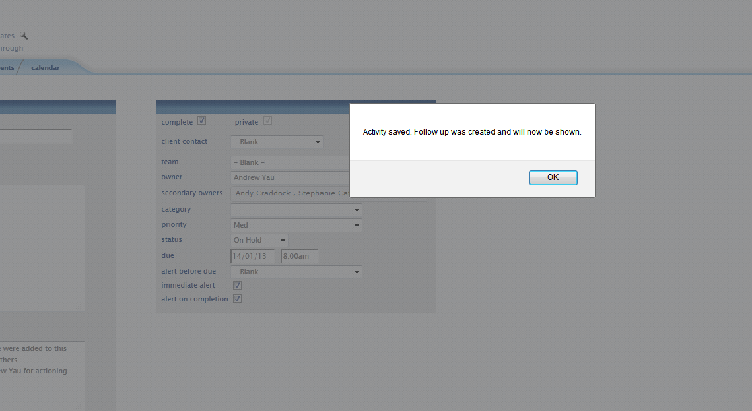
Production completing the task activity
Once you click on follow up, this will show which is normal. Click OK!

Slide 31
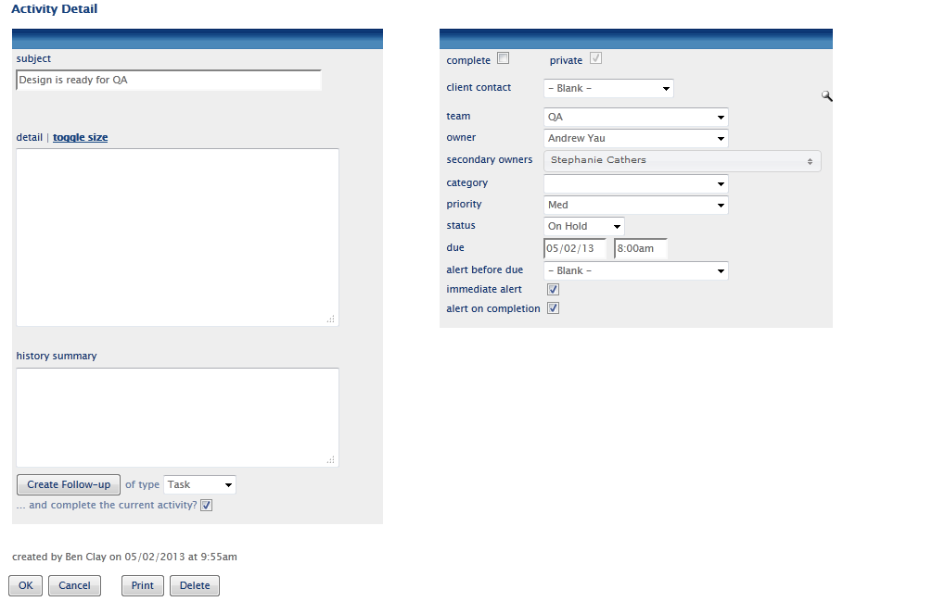
Production completing the task activity
Add a subject line
Add QA Team
Add owner who is Andy Yau
Add secondary owners – Stephanie Cathers
Ensure both Tick boxes are checked in "alerts”
Immediate alert
On completion

Slide 32
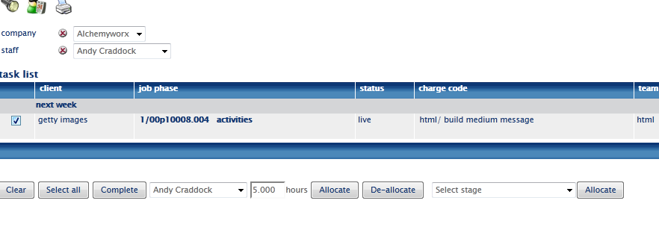
Production completing the task activity
Once you have added your time and you have completed the task you will need to ‘complete’ the task and ‘complete’ the requisition request. Note: Only complete the task as per below if you know it has passed QA and been passed back to the CM.
Completing the task
Navigate to “my tasks” tick the box to the left, then click on complete at the bottom (this will now remove it from the scheduling calendar)

Slide 33
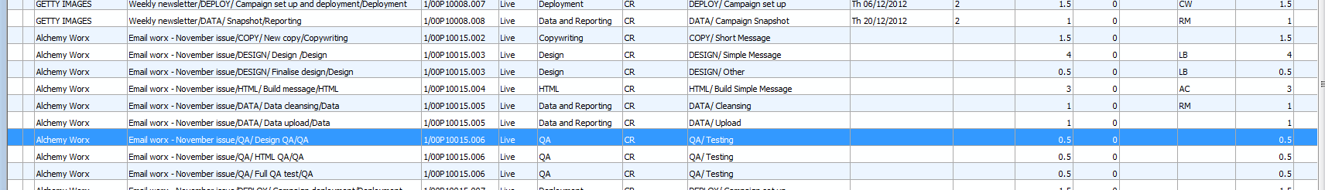
QA stage
Once the task has been completed by HTML, Design or Deployment teams the team leader/QA/CM team will receive an email notification it has been done
QA team to have a discussion on who completes the QA stage
The QA staff member will need to select, and drag and drop the correct stage from the calendar bookings to their diary (see slide 71)

Slide 34
QA stage 2
QA staff member to start their stop clock and calculate time spent on job, (following the same process as the production team member described earlier on slide 78)
If job has passed QA:
QA complete requisition and task (following the same process as the production team member described on slide 83) .
An email is then sent to the CM with a link to the JPEG’s or HTML previews (The job is now back with the CM)
If job has failed QA:
QA complete a follow up to Design team (following the same process as the production team member described on slide 84-86).
They should also send an email as per the current process.

Slide 35
At the end of the day…
You need to do two things:
Post all your pending timesheet entries – very important! (instruction below)
The CM should be completing the tasks throughout the day so jobs will disappear from your task list. If one is still showing and you know it is complete, then flag with the CM.
Post all entries at the end of each day

Slide 36
Production posting timesheets
Post all entries at the end of each day

Slide 37
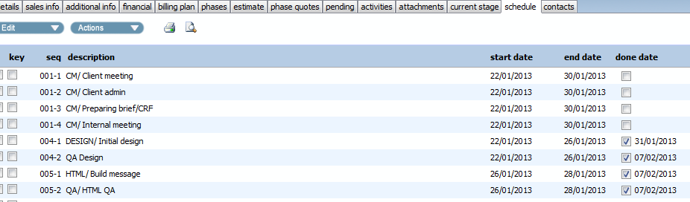
Job is now back with the CM
If CM is happy that job has been completed ok and is fine to send to the client the CM will now complete the stage (except for the ‘deployment ‘ and ‘amends ‘phase .The deployment stage is only completed once the email has been deployed. Amends is completed once signed off)

Slide 38
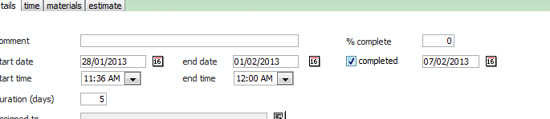
CM Completing the stage/task
Navigate to the schedule tab, double click on ‘done date’ and tick the ‘completed box’

Slide 39
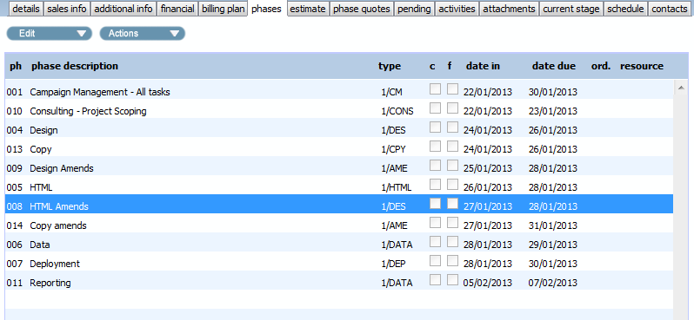
CM briefing in Amends
Stages of design/HTML/copy amends are already listed for each job as part of the template underneath the phase of ‘design amends’ ‘HTML amends’ ‘copy amends’ or ‘deployment amends’
Double click on the ‘amends’ phase you want to use and navigate to the stages screen.

Slide 40
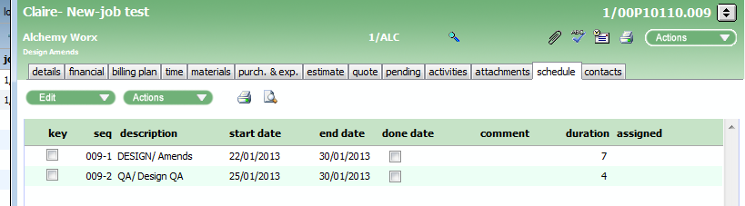
Briefing in Amends - 2
Double click on the ‘Design/amends’ stage
You will need to add a time estimate and ensure the charge code is completed

Slide 41
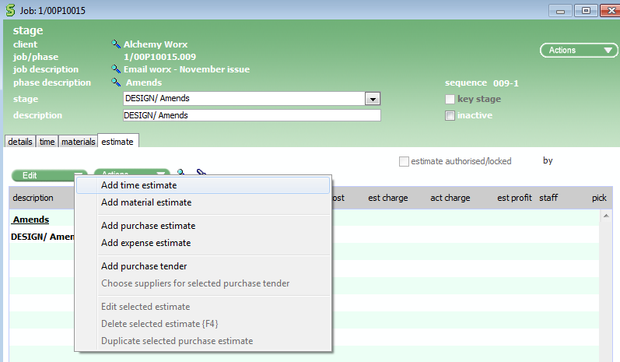
Briefing in Amends - 3
Click on ‘actions’ and then select ‘add time estimate’

Slide 42
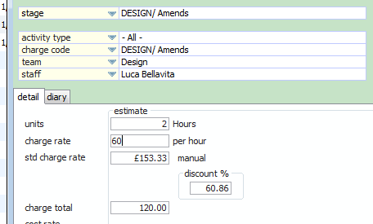
Briefing in Amends - 4
Add charge code of ‘DESIGN/Amends’
Assign it to design team
Add units of time/estimate for job
Add the amends fee, if the amends are incurring a fee. Otherwise keep it as £0

Slide 43
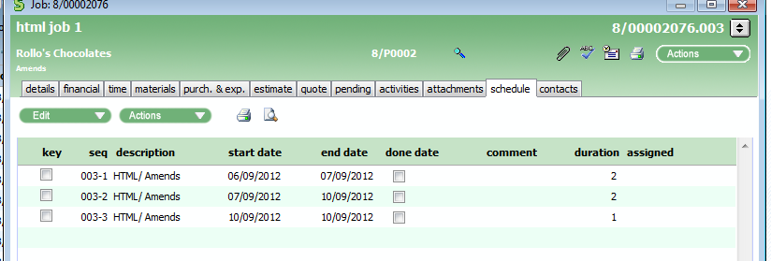
Briefing in Amends - 5
For each round of amends, you will need to create a new stage entry of HTML , design or copy amends. With each round of amends you will need to raise a requisition – is this correct?

Slide 44
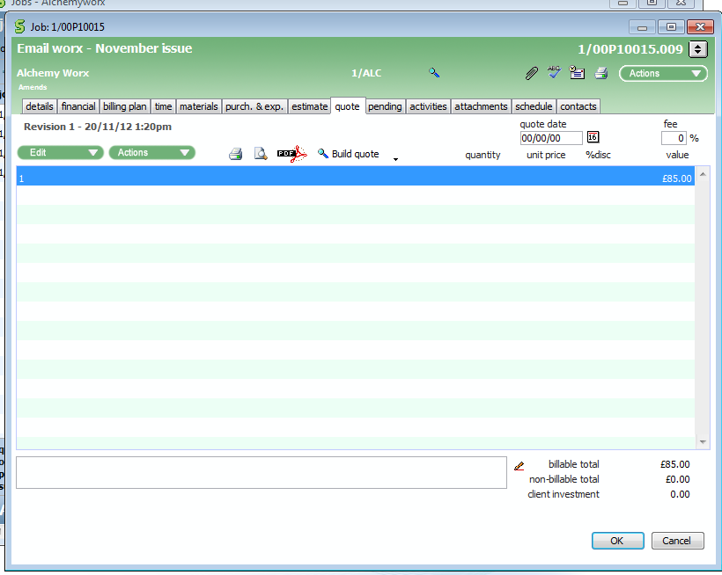
Amends – adding client charges/quote
Click on ‘quote’ tab

Slide 45
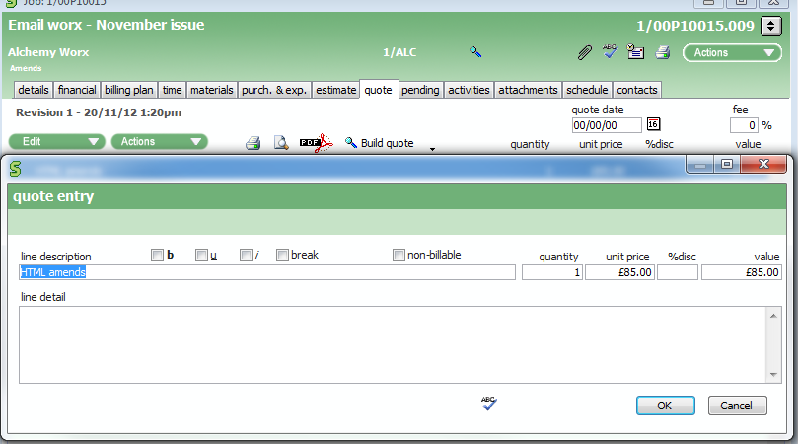
Amends – adding charges/quote - 2
Click on ‘edit’ and then ‘add line’
Enter ‘line description’ and ‘unit price’ /charge of amends

Slide 46
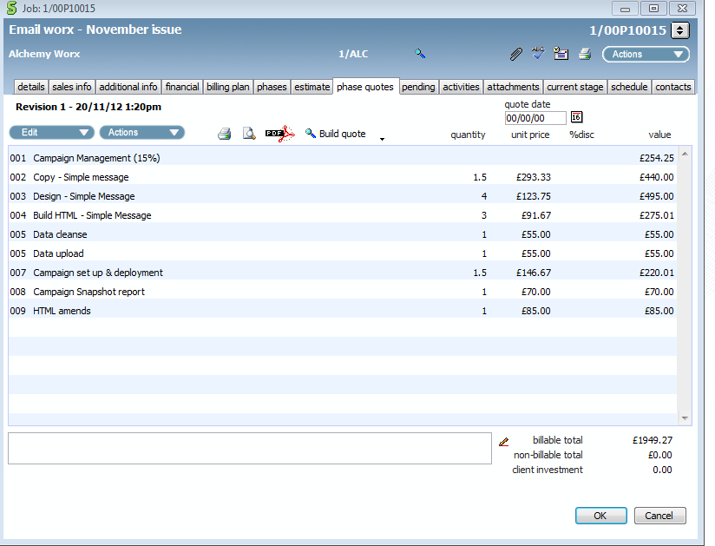
Amends – adding charges/quote - 3
The line entry will now be on the ‘phase quotes’
Important! You will need to amend the CM fee if it is a % of job total

Slide 47
Amends – briefing into production
CM and production team member to follow the same process as outlined earlier
CM to raise requisition request
Production to schedule out amends tasks and ‘complete’ tasks, requisitions as they complete

Slide 48
CM – Design/HTML/Copy
The process for briefing in jobs to the design/html/copy/ teams is the same on Synergist
Once the initial stage is complete all future tasks are briefed into production under the ‘design amends’ ‘HTML amends’ ‘copy amends’ phases/stage.
Once you get to the deployment phase/stage there are a few slight differences

Slide 49
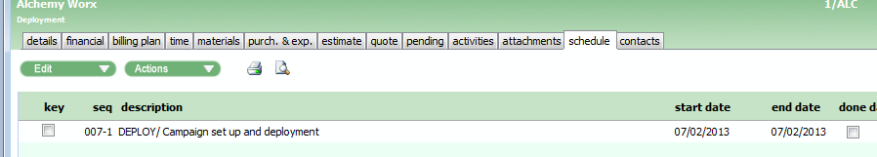
CM – Deployment
For deployment, only have one stage against this phase.
So unlike HTML and design, the ‘QA’ part of the job is a separate stage which needs to briefed in separately to the campaign set up
The only stage that should be under deployment phase is ‘campaign set up and deployment’ unless it is a ‘trigger email set up’ which has different costs associated with it
Raise a requisition to deployment and indicate what you need them to do in the SL of the requisition such as ‘send tests’ or ‘send approvals’ etc. All info should also be in ‘to do’ sheet on CRF

Slide 50
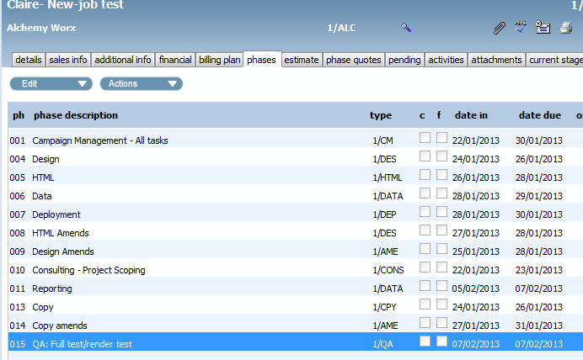
CM – Deployment/testing: 3
You also need to brief in ‘full test/render’ test stage/task to the QA team complete if this required after the campaign has been set up
Navigate to the ‘QA: Full test/render test’ phase. (Deleting render test or full test as appropriate)

Slide 51
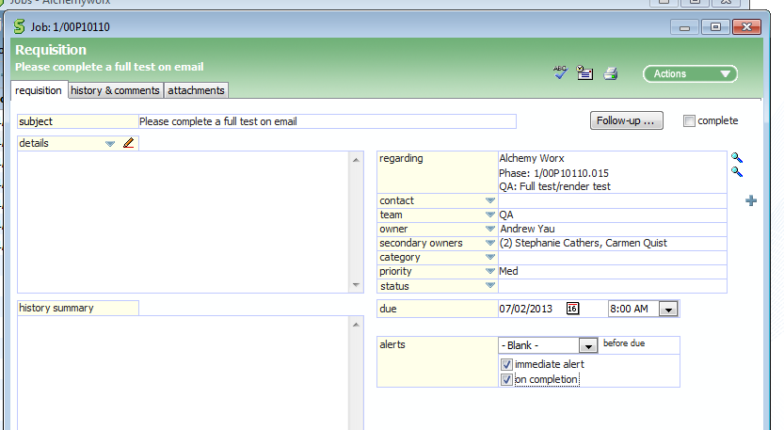
CM – Deployment/testing: 4
Raise a requisition as usual to the QA team to complete ‘testing’
Team should be set to ‘QA’
Owner to ‘Andrew Yau’
Secondary owners ‘ Stephanie and Carmen’

Slide 52
CM – Deployment/testing: 5
If re-tests need to be briefed in, raise another requisition against the ‘full test’ QA stage stating ‘please retest against previous errors’ in the SL of the requisition

Slide 53
CM – Deployment/testing: 6
The stage of deployment (unlike design/copy/html) should only be completed once the email has been deployed

Slide 54
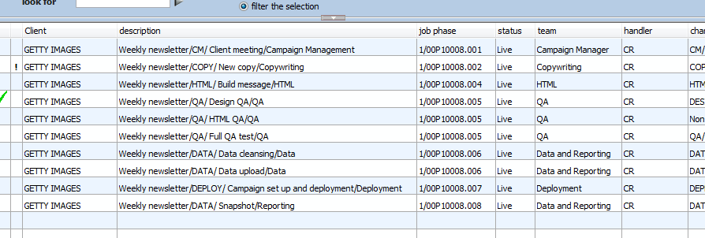
Once job is complete
As you complete each stage the stage will be removed from ‘calendar bookings’ as a stage need to be worked on until it is completed

Slide 55
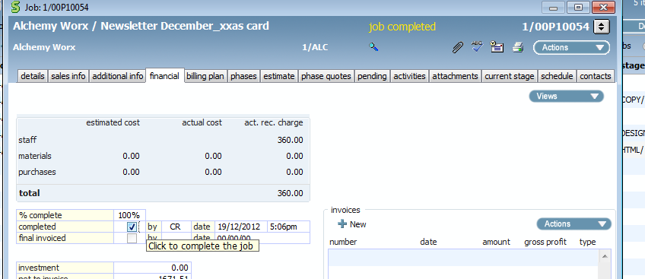
Once job is complete
Navigate to the financial tab and tick ‘completed’
This will remove all stages from calendar bookings and remove job from ‘open jobs’
The job is now complete except for the invoice

